Slide 1
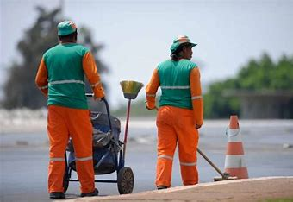
a.I project to help people in brazil
How recycling can be easier

Slide 2
summary
An app that can call a trash collector, for each type of residue, any time you want, and you can see where they are in real time

Slide 3
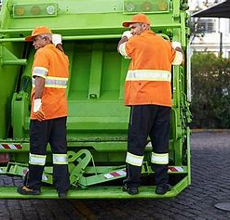
background
When I lived in Brazil, it was difficult to dispose of your residues because there is no differentiation between them, so we must throw everything in the same place. There were some guys that collected the paper or plastic bottles, but the did it on their own to earn some money.
This app would help connect people that want to do selective recycling with the people that can collect them and correctly dispose them.

Slide 4

How is it used?
Enter your data
Enter the type of trash
Choose the time that is better for you
Take out your trash in an easier and more organized way
The users would input their address, which type of trash they have (plastic, paper, glass etc.) and the time that they want the worker to arrive there, and the app will give them the name and photo of the worker that will collect their trash. Like that, is easier to know when to take out the trash, and the workers do not need to run around the city.

Slide 5
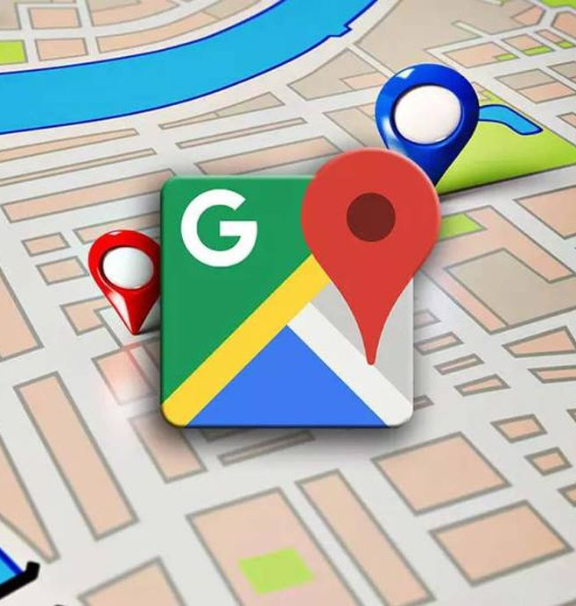
Data sources and ai methods
We will need geolocation apps like google maps, etc, to help with the location and some AI methods to help integrate all the necessary communication between the client, the collector and the company that receive the different residues.
It has also to create the fastest route for the collector, so he can be more efficient.

Slide 6
Challenges
The project sounds easy, but the app has to give the information to the user really fast. There could be no workers available, or very few working at that time, so we would have to get everyone (workers and citizens) connected to the app, so it will not be a problem.
PROBLEMS
few workers connected to the app
no workers at all
giving the information slowly
not every citizen connected to the app
SOLUTIONS
try to organize the work between them
companies encouraging workers to dowload the app
use good technology and a good AI method
do campaigns in cities to dowload the app

Slide 7
The next step
A proof-of-concept could be built easily by one developer. The ideal results will be something like uber, or ifood, where you can put your order, but the other way around.

Slide 8
ACKNOWLEDGMENTS
Google maps

